Slide 1
Working with Node.js Modules

Slide 2
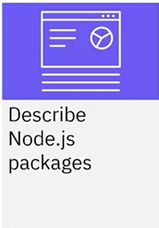
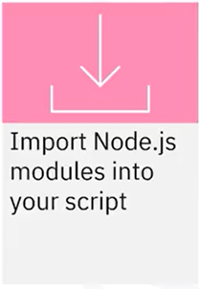
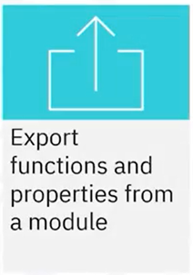
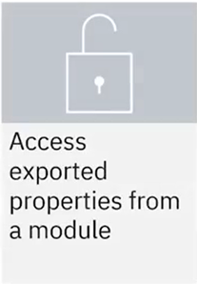
What you will learn

Slide 3
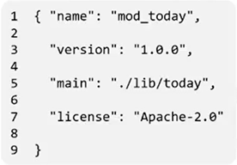
Package.json: the module manifest
• A package consists of one or more modules
• Every package has a package.json file that describes details
about a Node.js module
Index.js

Slide 4
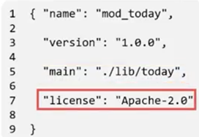
Package.json: the module manifest
• To specify a different main script for your module, specify a relative path to the Node.js script from the module directory
The name and version fields form a unique identifier
for the module
For example, today-1.0.0
The main field lists a path to the main node.js script
For example, the today.js script is in the lib
subdirectory
Package.json defines many other fields
For example, license states the module's usage rights
index.js

Slide 5

Importing Node.Js Modules
• Use the require function to import a Node.js module
• The require statement assumes that scripts have a file extension of .js
• The require function creates an object that represents the
imported Node.js module

Slide 6

Example: the require function
• To import a Node.js module that is packaged in a subdirectory,
use the require function with the name of the subdirectory
/mod_today/index.js
require('./mod_today')
Hello.js
Node.js script files

Slide 7
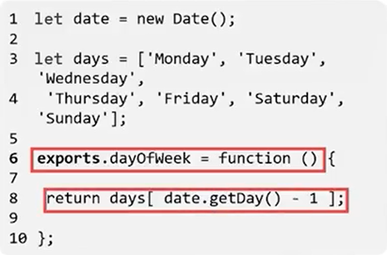
Export functions and properties
index.js
Each Node.js module has an implicit exports object
To make a function or a value available to Node.js applications that import your module, add a property to exports

Slide 8

Accessing exported properties
• When you import a Node.js module, the require function returns a JavaScript object that represents an instance of the module
• For example, the today variable is an instance of the today Node.js module called today

Slide 9
Accessing exported properties
• To access the properties of the module, retrieve the property from the variable
• In the same example, today.dayOfWeek represents the current
exported property from the today Node.js module

Slide 10
Recap
In this video, you learned that:
• Every package has a package.json file that describes details about a Node.js module
• To make a function or a value available to Node.js applications
that import your module, add a property to the implicit exports object
• When you import a Node.js module, the require function
returns a JavaScript object that represents an instance of the module

